Slide 1
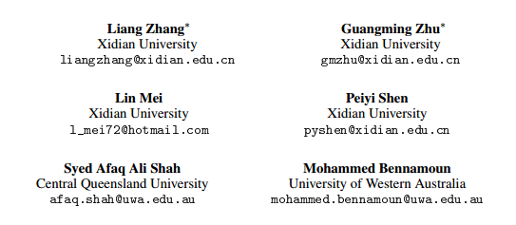
Attention in Convolutional LSTM for Gesture Recognition
论文核心：在ConvLSTM基础上加上注意力机制来进行研究。
发表于2018NIPS(神经信息处理系统大会)
被引用次数：15

Slide 2
The effect of the convolutional structures in ConvLSTM can be analyzed in three cases
ConvLSTM takes original images as input. In this case, the convolutional structures are crucial to learn the spatiotemporal features.
ConvLSTM takes the feature maps of 2DCNN as input. In this case, the effect of the convolutional structures is not always remarkable.
ConvLSTM takes the feature maps of 3DCNN as input. Since the 3DCNN networks have learnt the spatiotemporal features, the gates of ConvLSTM are more unlikely to have the function of spatial attention.

Slide 3
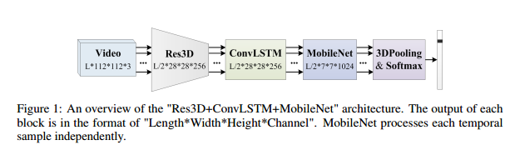
The Preliminary "Res3D+ConvLSTM+MobileNet" Architecture

Slide 4
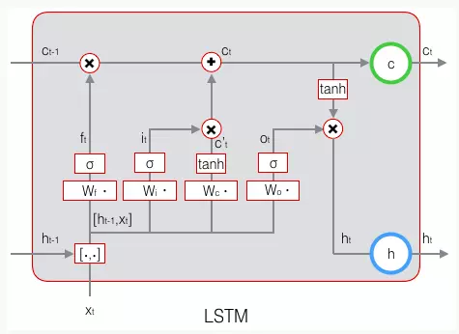
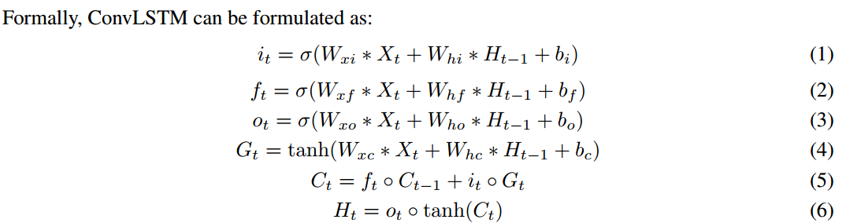
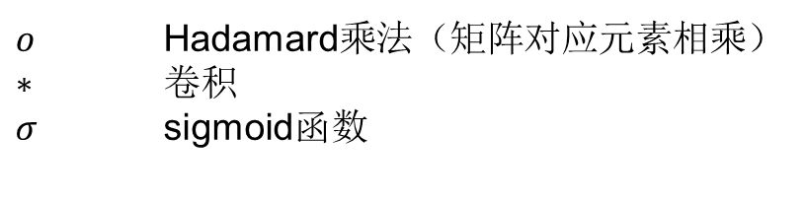
The Variants of ConvLSTM
$o$ Hadamard乘法（矩阵对应元素相乘）
$∗$ 卷积
$σ$ sigmoid函数

Slide 5
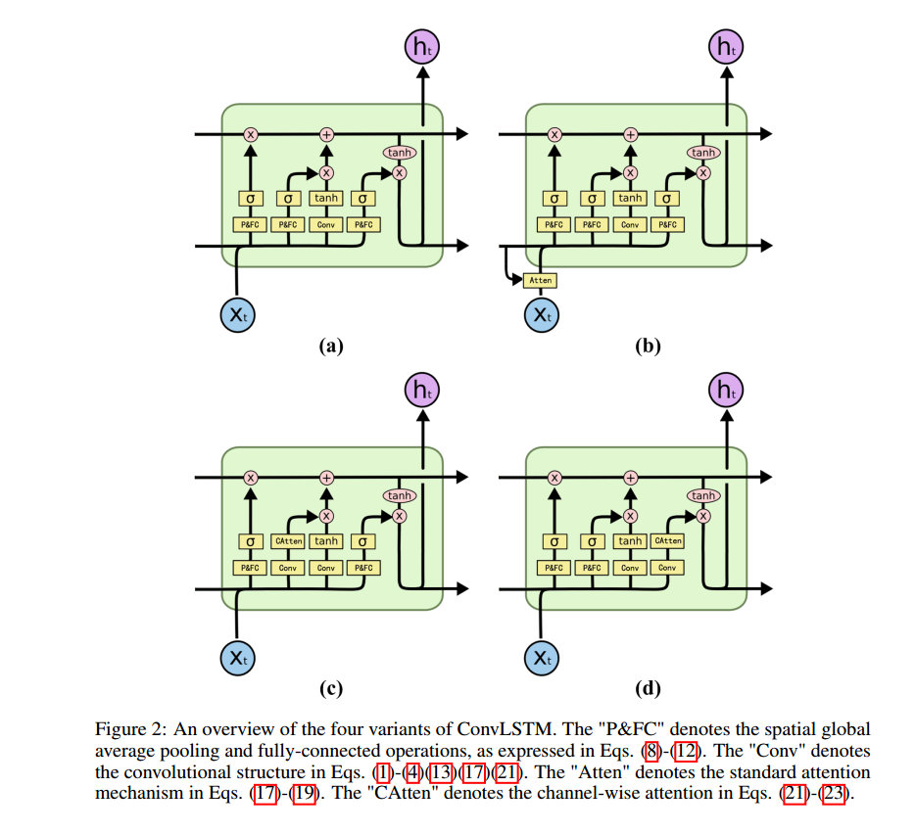
Four Variants of ConvLSTM

Slide 6
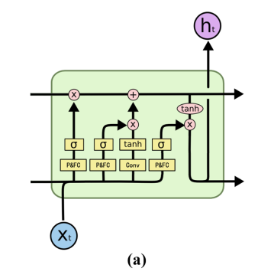
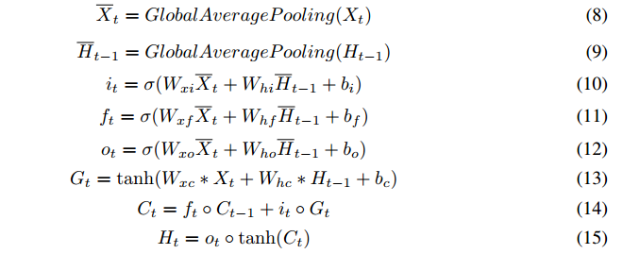
(a) Removing the convolutional structures of the gates

Slide 7
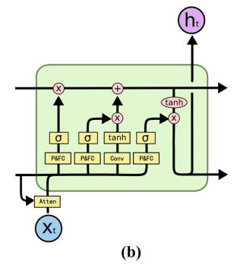
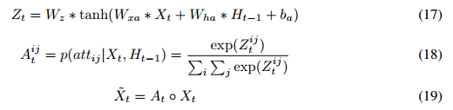
(b) Applying the attention mechanism to the inputs

Slide 8
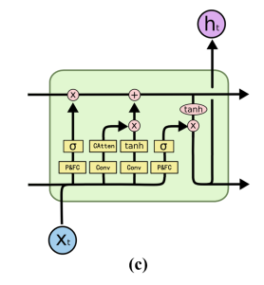
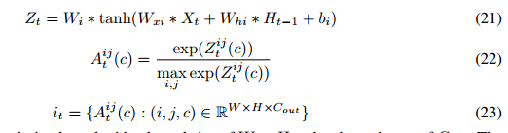
(c) Reconstructing the input gate using the channel-wise attention

Slide 9
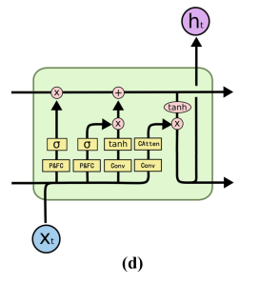
(d) Reconstructing the output gate using the channel-wise attention
b applies the attention mechanism on the input feature maps;
c applies the attention mechanism on the candidate memory.
d applies the attention mechanism on the cell state.

Slide 10
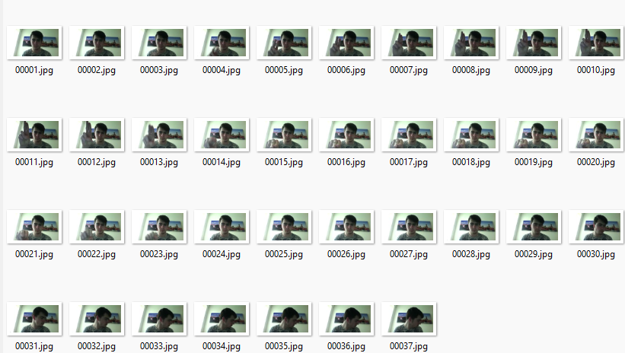
DataBase
Jester dataset includes 148,094 RGB video fifiles of 27 kinds of gestures.
IsoGD is a large-scale isolated gesture dataset which contains 47,933 RGB+D gesture videos of 249 kinds of gestures performed by 21 subjects.

Slide 11
Implementation Details
The Res3D and MobileNet components are deployed from their original versions.
The ConvLSTM are first trained on the Jester dataset and then fine-tuned using the IsoGD dataset.
The input is 16 video clips, and each clip contains 16 frames with a spatial size of 112 × 112.

Slide 12
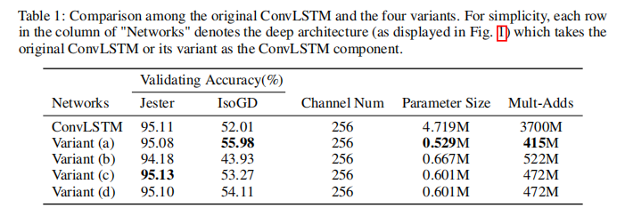
Explorative study
The lower accuracy of variant (b) may indicate the uselessness of the extra attention mechanism on the inputs, since the learnt spatiotemporal features of 3DCNN have already paid attention to the noticeable spatial regions.
The comparison on IsoGD shows that variant (a) is superior to the original ConvLSTM.

Slide 13
Conclusion
ConvLSTM门的卷积结构没有发挥空间注意的作用,三门卷积结构的减小导致了更好的精度、较低的参数大小和较低的计算消耗。(变体a）
在输入和输出门中嵌入的特定注意机制不能促进特征融合，但它只会带来额外的内存和计算消耗。

